Slide 2
Disclaimer
You have seen it before but putting it here again: Do not attack or hack any systems that you do not own or that your are unauthorized to attack. Always make sure that you have permission or know what the consequences could be. The existence of a vulnerability is not an invitation!

Slide 3
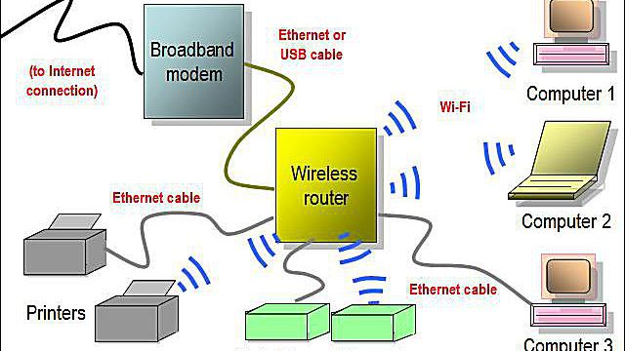
What is Wifi?
To understand wifi, we must go back to how we originally (and still do) were able to connect devices.
In order to transfer data between one computer and another we needed to connect them physically with a wire, which is ethernet.
As we connect more and more devices together, we get what is called a network*
With the introduction of sending data over radio waves (out of scope of this workshop), comes the introduction of having the chance for computers to communicate through waves rather than through wires.
An Access Point is some device that will allow for other devices to get connected to a network, instead of ethernet. It is these devices that make wifi “wireless”. A router is usually a good example of an access point.
*Side note: the internet is just a huge network of connected devices. Everything on the internet is connected in some fashion, even if not directly.
The only reason why you are connected to the internet when connecting to most Access points, is because their routers are connected to the internet through an ISP and your connected to their routers!

Slide 4
More into Wifi
“Wifi” or IEEE 802.11 is the standard for the protocol (or rules) put in place for wifi connected devices to talk to each other.
It is important to know that besides the main difference of using Radio waves and a wire, is that wires makes the data only go through the wire, and only those connected to the wire could listen in. With wifi however, because there is not a defined link between a router and a device so wifi gets sent everywhere, and anyone can actually see anyones traffic!
Thankfully, most wifi cards are made to specifically only listen for traffic meant for your device! But some have something called “Monitor mode” Which will be able to listen to all traffic that the card is in range of.
It is this Monitor mode that allows us to see any wifi data packets. This means that even if you didn’t own a network, if you were in range of an access point, you could see everything.
This is not good, but is the reason we have…

Slide 5
Wifi Security
With ethernet, you usually do not have to login or anything. As soon as you connect to ethernet there is a connection. The only security here is if you make some other access portal to make sure that only allowed devices can see certain things.
However, due to the nature of Wifi, there needed to be some security and encryption added in order to protect our data from malicious people.
This is why people say you shouldn’t join open wifi networks! As by doing so your traffic becomes free to anyone to see! Thankfully (but out of scope) secure protocols like HTTPS exists to further encrypt your network traffic.
There are a few main protocols that were made in order to both authenticate users and encrypt their data.
Another important note: A lot of stuff relating to newer technologies and such, are not included here or purposefully skipped for simplicity. This is a complex topic, so if this does interest you I recommend looking into it yourself!

Slide 6
Wifi Security Cont.
By using a “password” as a key, we can encrypt the traffic. Think back to the cryptography meeting (if you werent there, think of the password as a lock that can hide and show data, and allow you to interact with other devices on a network)
Authentication: Make sure a user is allowed to establish a full connection with a network
Encrypted: Make sure that the data transferred on a network is encrypted and hidden from those not on the network.
I won't explain too much about how each protocol work at the lower level, but feel free to look and learn on your own time!

Slide 7
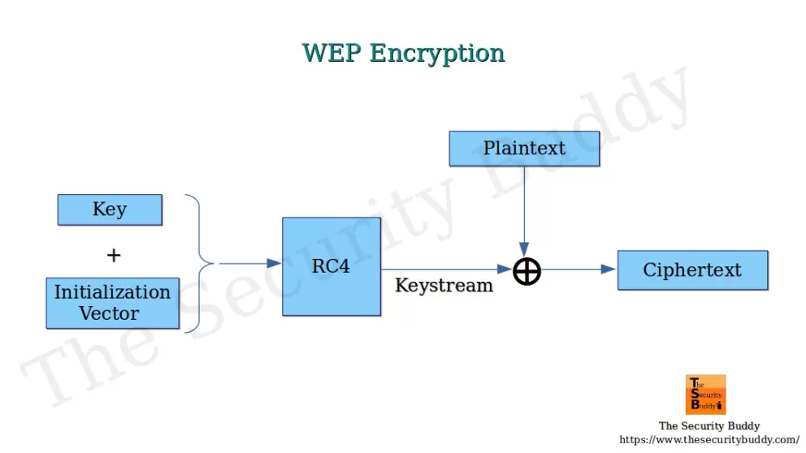
WEP
WEP, aka Wired Equivalent Privacy, was originally made to combat this insecurity in wireless networks back in 1997.
If you don’t understand the below image, that is fine, the important takeaway is the use of a stream cipher and initialization vectors.
Because you constantly use the same key over and over with these initialization vectors, it makes it easy to crack the password no matter what it is, using purely math and no brute force, or wordlist.
In other words, since these IVs are public (needed to even decrypt traffic), if an attacker just listens to a network and gains a lot of packets, they can get the password!
This is why it is not a standard today, but people and companies will still use it, sometimes companies wont fix what isnt seen by them as “broken”.
Note: We wont crack actively attack WEP today because it is very easy to do so, but also because you need a lot of IVs. For reference, when I was doing it on a router with traffic I was making malicious (with permission), it took nearly 45 minutes of traffic!

Slide 8
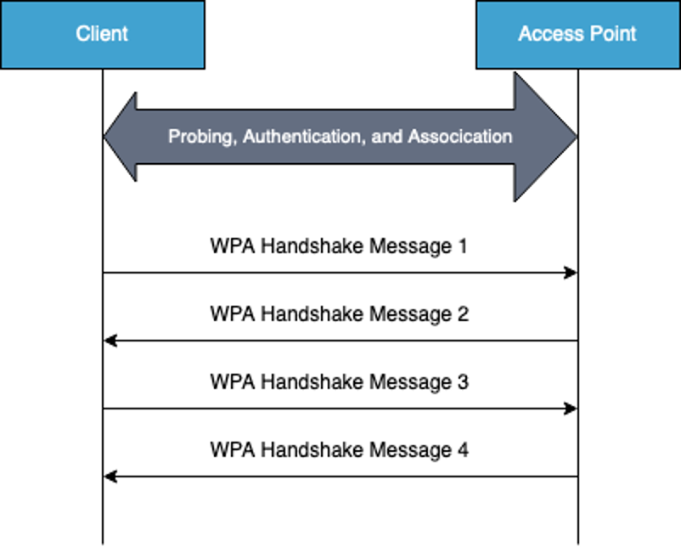
WPA/WPA2
WPA (Wifi protected access) and WPA2 Is what we mostly use today
WPA and WPA2 are very similar, the main differences is that WPA2 update the encryption used.
There is a WPA3 now, but that is out of scope as the method of cracking is virtually impossible (still is theoretically!)
The important Difference is the “4 way handshake” that was added. To authenticate users to a network wirelessly.
Whenever a user connects to a network, they will initiate the 4 way handshake, but only when they connect to it.
By capturing this 4 way handshake as an attacker, it is possible to crack the password, with the security relying now on the strength of the password.
Today we will be demonstrating how you can do this.

Slide 9
Last Important Definitions
IP Address: Ways we can find a device (think of a home address in relation to your home) on the Wider Area Network, such as the internet.
MAC Addresses: Ways we can find a device on a local Internet. Unlike IP Addresses usually you only have one of these and it is unique to your specific device.
Channel: Because wifi is defined on the same frequencies (Either 2.4ghz or 5ghz), A lot of devices and network close together can cause interferences with each other. Channels are different frequencies that are close to the main frequencies, but offset by some amount to prevent interferences.
BSSID: The MAC Address of the specific access point.
ESSID/SSID: The name of the network, like “eduroam”. These have a slight non important to us now difference, so they essentially mean the same thing.
Interface: The thing that bridges the connection between a device and the network. Think of an ethernet port or wifi card. This connection does appear magically on a device.

Slide 10
Lets get Cracking
Make sure you are on a computer that has access to sudo! A lot of things such as low level packet manipulation will require you to be the root user. I personally recommend doing “su” and then logging in as the root user, but I will be typing the commands including the sudo. Feel free to remove them if you are root.
We also only have enough external wifi adapters for two people to get one, so you will have to do this with a partner! Make sure that you work together to fully understand the process.

Slide 11
Before we Crack…
One thing to mention again is that WEP requires getting a ton of traffic into a file (approximately 10k to 20k IV’s) which even though you can generate this traffic artificially, for reference, it took me about 40 minutes of collecting my artificial traffick to crack it! Slow, but if its a big company network then it wouldnt be long.
We will be cracking WPA2 today as the only requirement of it is that we get the 4 way handshake. We can either wait for a device to connect to get this or force a device on the network to disconnect, to catch its reconnect. However…

Slide 12
IMPORTANT
Be *VERY* Careful and vigilant of everything you type. You can theoretically break the law in the next few moments if you accidentally do something such as a deauthentication attack on unr’s network instead of the router. Make sure that both partners understand and check each thing before running a command. Failure to do so may lead to bad things. Dont worry too much, but just a general warning! The BSSID should be “60:38:E0:12:AE:14” of the router, assuming you are using rainbow Inc. That being said…

Slide 13
Installation of the Aircrack-ng Suite
Aircrack-ng has a ton of tools for wireless security auditing, such as monitoring, cracking, and deauthing. As a disclaimer use of these tools incorrectly or on things you do not own (including wifi networks! Note that own DOES NOT MEAN “know the password to”) can lead to serious legal trouble.
Any to download this (on ubuntu) just run the following command!
sudo apt-get update && apt-get install -y aircrack-ng

Slide 14
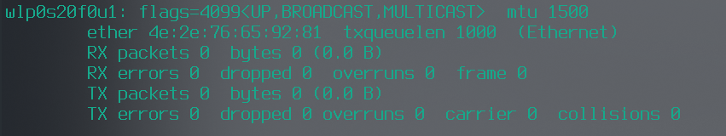
Lets start!
In terminal run “ifconfig” and keep the results.
Plug the adapter in, run “ifconfig” again and look at the differences. There should be a new entry, reference below to figure the adapter name out.
Below I have copied my output. Your names will be different since my linux distro is diff but the concepts are the same:
“wlp0s20f0u1” is the name of the wifi adapter in our computer and the important one. There may be other entries but look at the new one!
Dont worry about anything else here. If you are curious however, I implore you to look into this output on your own time.

Slide 15
Starting the wifi adapter
Now for the fun stuff!
Using the name that you got last slide run “sudo airmon-ng start <adapter>” replacing the adapter name with your adapter (dont include the <>)
Normally before this we would have to do “sudo airmon-ng check kill” but because we are using this external adapter we dont have to!
Do ifconfig again and see that the adapter name has changed to have “mon” at the end. Consider this to be the adapter name moving forward

Slide 16
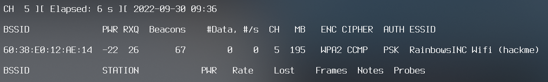
Looking for wifi
To see all of the networks our adapter can see run “sudo airodump-ng <adapter>”
After you see the “RainbowsINC” below, press ctrl+c to exit airodump.
Now because of the nature of wifi we will be able to see other networks! If you dont see the Rainbow Inc network after a minute, then add “--channel 5” to the command. If that doesent work, try adding ‘ --essid “RainbowsINC Wifi (hackme)” ’.
Note the CH (channel), and the BSSID of the network, we will need these later
Now that we have the bssid, and you have ctrl+c’d you can now start looking for a client!
Remember to check the man or help pages for more commands! There are a lot of other useful commands like searching for certain encryptions and such that we wont go over.

Slide 17
Looking for a Handshake
Remember that 4-way handshake that wpa2 has when a client connects? Well in order to crack it we need to get it. There are two methods of getting it.
We can wait for a client to manually connect while listening
We can force a client to disconnect for them and listen to their reconnection
“Wait you can do that??” Yep! Because of how wifi works you can literally spoof a client, and go to the router and essentially say “I swear I am this device, but Im disconnecting” and by doing so the router will disconnect, but because the device didnt do this it will attempt to reconnect, which the router will require the 4way handshake again.
Its important to know that If you disconnect for too long that it can make the client connect to a better wifi automatically, meaning you dont get this handshake. You also cant crack a wifi network if there are too many deauth packets! Keep that in mind.

Slide 18
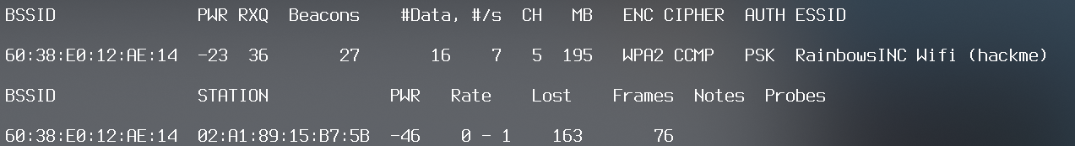
Looking for a Handshake Continued
To actually find a client do “airodump-ng <adapter> --channel <ch> --bssid <bssid>”
Similar to the output below, You should the see the bssid of the network and a “station”
This station is our client! This can be a wifi camera, phone, etc. Just a device connected.
The actual hex numbers there is the MAC Address of the device (bssid is MAC of router)
Take note of the MAC address of a client (In lab they will tell you what one).
You can skip above steps if you deauth a whole network (yes that is possible to, no I am not showing that one, but will indirectly say how so you dont) or if you just want to wait for a connection to manually happen.
Ideally the best, least noisy way is to wait and listen as then we have not ever sent a single packet or did anything possibly destructive! Next would be to deauth a single client, A bit noisy, but deauthing a network would be super noisy intrusive and illegal. Just remember you dont know what is on a network, so as a pentester this is really careless to do.

Slide 19
Looking for a Handshake: Finally Capturing it
Now you will need another terminals (either as root or with sudo)[next slide for visual]
Stack both of the terminals together for ease of use, and type (Do not run) the following:
Terminal 1: “sudo airodump-ng <adapter> --channel <ch> --bssid <bssid> -w <output file>”
Terminal 2: “sudo iwconfig <adapter> channel <ch>; sudo aireplay-ng --deauth 3 <adapter> -a <bssid> -c <client MAC>
For terminal 1:
This command will put the network traffic the adapter sees into a packet capture file as well as some other information. This will be ran (not yet) before Terminal 2.
For terminal 2:
first command makes the adapter on the channel of the wifi network
The second one is the dangerous command. If you fail to add a specific client this will end badly. This is what is going to make us deauth the client from the network.
Essentially the deauth count is how many times we try to. Usually 3-5 is find but too many times can cause the client to connect elsewhere or even stop it from wanting to connect to anything.

Slide 20
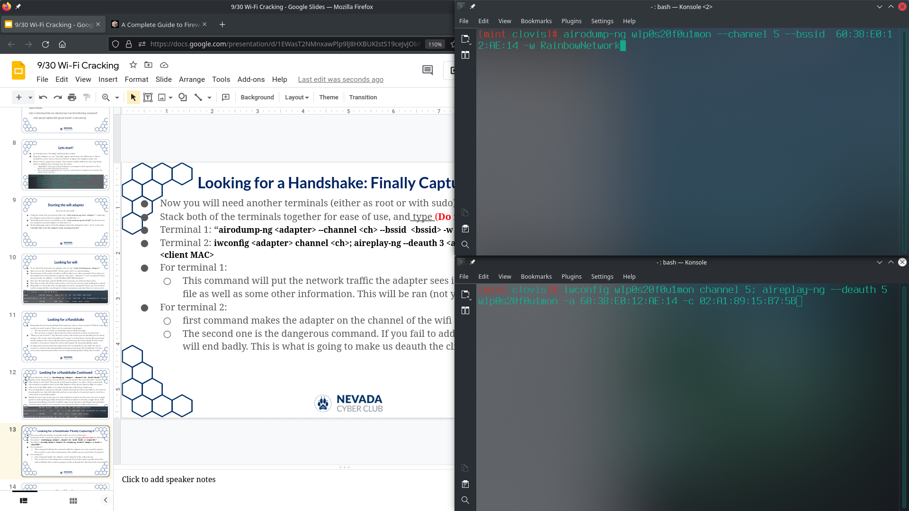
Looking for a Handshake: Finally Capturing it

Slide 21
Looking for a Handshake: Finally Capturing it
Now Just because we cant have too many deauths in a packet capture, we will go group by group testing it out! Making sure that the client gets connected back each time.
When it is your turn you will do the following
Run the terminal 1 command first (the one with airodump-ng)
Run the terminal 2 command
Assuming this is successful you should see a “WPA handshake” at the top right of terminal 1 (make sure terminal 1 is long enough)
If this was successful, stop terminal 1 and move to next group. If not, try deauth again. Take note on how each deauth will effect the Frames and Lost of the station.
Next slide is example of a success

Slide 22
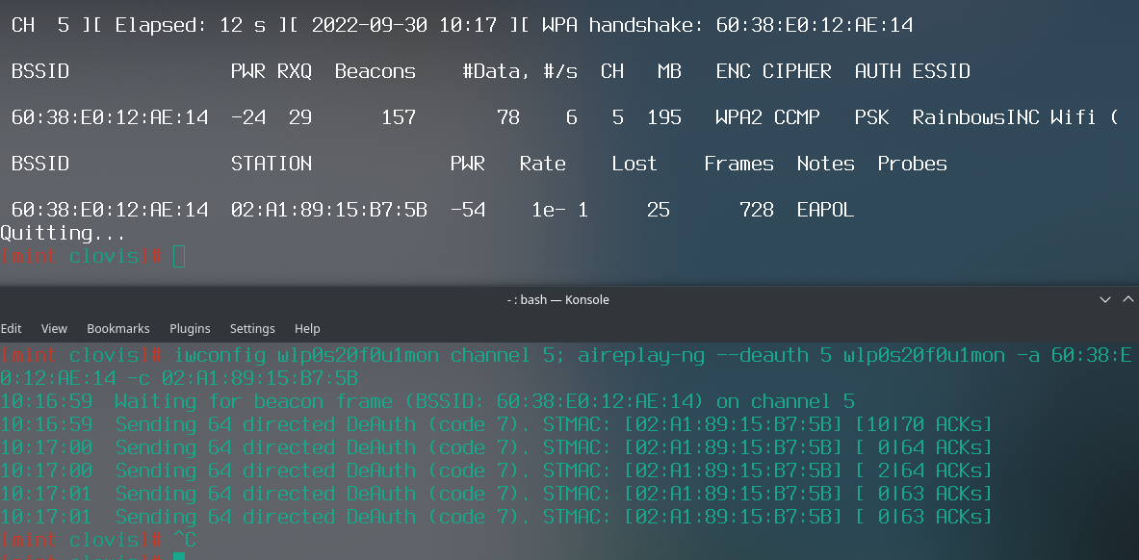

Slide 23
Summary of Getting a handshake
We did it! That was the hardest part.there are many ways to do it, but here is a tldr
An important tip is if you are looking at 5ghz Networks to change the channel to a 5 ghz channel, otherwise the adapter wont listen to it as default is the 2.7ghz (assuming it supports 5 ghz)
First Find the BSSID and Channel of the Network to crack.
From here you have a few routes you can take, desired route:
Writing to a file, listen to the network and wait for a wpa handshake
Less desirable route
Find the MAC Address of the client/station
While writing to a file, listen to the network.
Deauth the client
The “Dont do this” route that might be needed so good to know but still really shouldnt
While writing to a file, listen to the network.
Deauth all the clients associated with the network.

Slide 24
Cracking the Handshake
Now we dont need to use the adapter any more, so you can unplug it, please dont forget about it.
With the file there are a few ways to do it. One way is to convert is so you can use it with a password cracker like “John” or “Hashcat”
This has its plus sides as now you can apply password cracking rules and such easier, and have access to what they offer
For john, assuming you have it, use “pcap2john” (one of the many tools that gets automatically installed with john”
For hashcat, you can use https://hashcat.net/cap2hashcat/, and mode “-m 22000”
The other option that we will do is using aircrack-ng itself!

Slide 25
Cracking the Handshake
Make sure for WPA that you have a wordlist! With wep, if you have enough IV’s, you dont need a wordlist (it is outdated for a reason!) as it can get the password using statistics and such (complicated to talk about whats happening at the low level and out of scope, but a you just need a single command to do it with aircrack!)
For this capture file the password located in the “rockyou” data breach
People in the lab should be able to help you download this, but you can easily find this online as it is a very common wordlist to use for researchers.
Once you have the wordlist downloaded run the following
sudo aircrack-ng <outputfile>.cap -w /path/to/wordlist/rockyou.txt
Now we just wait…

Slide 26
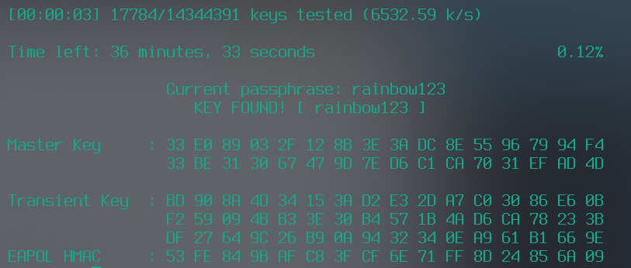
Cracked :P
Reminder: Dont use poor passwords like this on anything…

Slide 27
Closing notes
Make sure you always understand what you are doing before running random commands. Not just so you don’t get affected, but so others don’t either.
In your free time I highly recommend looking at the cap file when you deauthed in something like WireShark, that you can see how noisy this can actually be.
Its important to know that this isnt just giving attackers “free wifi”. Once an attackers is on a network, they are able to see devices on that network that would normally not be accessible. Security is only as strong as its weakest link!!!
If you want to practice at home, mobile hotspots should work, but if its 5ghz make sure that you set your channel to indicate that!
It is important to know that not all wifi cards and adapters support this monitor mode, and if yours does, you have to add that “check kill” referenced earlier. You can usually find out through googling and such if your does. If not you will need to get an external adapter that does support it.
Remember this is a difficult thing. If you need any help feel free to contact me or do further research online. For NCL you dont have to do this complicated part, just analyzing the file and cracking the network.

Slide 28
Closing notes
Lastly, again, do not do any of this on stuff you do not own :). This is good knowledge to know when you do a pentest, and is not meant to be stealthy in the slightest. If you do illegal stuff you will get caught eventually.

